Slide 1

Knowledge Intensive Language Task With Case Study in Compliance Requirements
Kavin R V
19163
Adviser: Dr. Arpit Sharma (EECS), Dr. Jasbanta Patro

Slide 2
Motivation

Slide 3

Semi-Parametric Models
DataBase
(Wikipedia, Documents..etc)
Answer
Search
Parametric Model
Top K
H6
(Non Parametric)

Slide 4
Semi-Parametric Models
DataBase
(Wikipedia, Documents..etc)
Answer
Search
Parametric Knowledge
Parametric Model
Top K
H6
(Non Parametric)
Non Parametric Knowledge

Slide 5
Semi-Parametric Models
Main idea is instead of relying on either part these models combine both these knowledge base
DataBase
(Wikipedia, Documents..etc)
Answer
Search
Parametric Knowledge
Parametric Model
Top K
H6
(Non Parametric)
Non Parametric Knowledge

Slide 6
Semi-Parametric Models
DataBase
(Legal Documents, Claims..)
True/False
Search
Parametric Model
Top K
H6
(Non Parametric)

Slide 7
Semi-Parametric Models
DataBase
(Web, Chat History, etc..)
Dialogue
Search
Parametric Model
Top K
H6
(Non Parametric)

Slide 8
Open Domain Question Answering
DataBase
(Wikipedia, Documents..etc)
Answer
Search
Parametric Model
Top K
H6
(Non Parametric)

Slide 9
Open Domain Question Answering
DataBase
(Wikipedia, Documents..etc)
Answer
Search
Parametric Model
Top K
H6
(Non Parametric)

Slide 10
Research Gaps

Slide 11
Fusion in Decoder (FiD) Model
Encoder
Answer
(Autoregressively)
question:...
title:...
passage:...
Decoder
Encoder
Encoder
Used as key and value in decoder’s cross attention mechanism

Slide 12
Problems with FiD
Encoder
40-100
Answer
(Autoregressively)
question:...
title:...
passage:...
Decoder
Encoder
Encoder

Slide 13
Problems with FiD
Encoder
40-100
Answer
(Autoregressively)
question:...
title:...
passage:...
Decoder
Encoder
Encoder
512

Slide 14
Problems with FiD
Encoder
40-100
Answer
(Autoregressively)
question:...
title:...
passage:...
Decoder
Encoder
Encoder
512
51200!

Slide 15
Problems with FiD
Huge Models
(220M-11B!!!!)
Parameters
Encoder
40-100
Answer
(Autoregressively)
question:...
title:...
passage:...
Decoder
Encoder
Encoder
512
51200!

Slide 16
Objectives

Slide 17
Novel Approach as a Baseline Model
(In Closed Domain Settings)
Hierarchical Architecture
3D Visualization
Statistical Computing
Mathematical Analysis
Novel 3 module Hierarchical Architecture for Robust extraction of answer in Multihop Question Answering
Mayavi, Napari helps us in visualizing 3D graphs, which is hard to replicate in a 2D space. These Packages are helpful for almost all fields
Be it for finding a predominant feature or to get general view of what data we are using Statistical tools like Pandas and seaborn are very helpful
Scipy and Sympy can solve complex mathematical expressions which are helpful in fields like physics, Chemistry, Engineering etc...

Slide 18

Analysing the Effectiveness of adapters on the Baseline model
Hierarchical Architecture
Efficient Parameters
Statistical Computing
Mathematical Analysis
Novel 3 module Hierarchical Architecture for Robust extraction of answer in Multihop Question Answering
Analysed the effectiveness of different efficient parameter fine tuning techniques to be used in the bigger model
Be it for finding a predominant feature or to get general view of what data we are using Statistical tools like Pandas and seaborn are very helpful
Scipy and Sympy can solve complex mathematical expressions which are helpful in fields like physics, Chemistry, Engineering etc...

Slide 19
More Efficient FiD inference and Training
Hierarchical Architecture
Efficient Parameters
Modified Fid
Mathematical Analysis
Novel 3 module Hierarchical Architecture for Robust extraction of answer in Multihop Question Answering
Analysed the effectiveness of different efficient parameter fine tuning techniques to be used in the bigger model
Apply some nove architectural changes and add the tested adapters to the FiD architecture
Scipy and Sympy can solve complex mathematical expressions which are helpful in fields like physics, Chemistry, Engineering etc...

Slide 20

Case Study of these Models on Compliance Documents
Hierarchical Architecture
Efficient Parameters
Modified FiD
Compliance Requirement
Novel 3 module Hierarchical Architecture for Robust extraction of answer in Multihop Question Answering
Analysed the effectiveness of different efficient parameter fine tuning techniques to be used in the bigger model
Apply some nove architectural changes and add the tested adapters to the FiD architecture
Run these model and analyse the results on a compiled list of questions from compliance Documents

Slide 21
Case Study of these Models on Compliance Documents
Hierarchical Architecture
Efficient Parameters
Modified FiD
Compliance Requirement
Novel 3 module Hierarchical Architecture for Robust extraction of answer in Multihop Question Answering
Analysed the effectiveness of different efficient parameter fine tuning techniques to be used in the bigger model
Apply some nove architectural changes and add the tested adapters to the FiD architecture
Run these model and analyse the results on a compiled list of questions from compliance Documents

Slide 22
Methodology

Slide 23


Dataset For Training the QA Systems
HotpotQA
Multihop Question Answering
Train: ~90k, Validation: ~7k
Two Settings: Fullwiki, Distractor
Two types: Bridge, Comparison
Three levels: Easy, Medium, Hard
Model
Model
All of wikipedia, documents

Slide 24
Main Columns in HotpotQA
Question
Answer
Contexts
Supporting

Slide 25

Main Columns in HotpotQA
Question
Answer
Contexts
Supporting

Slide 26
Main Columns in HotpotQA
Question
Answer
Contexts
Supporting

Slide 27
Main Columns in HotpotQA
Question
Answer
Contexts
Supporting
_________________________
_________________________

Slide 28
Baseline Model
Module 1
(Selector)
Passage A
Passage B
Passage C
Passage D
Passage E
Passage F
Passage G
Passage H
Passage I
Passage J
Question

Slide 29
Baseline Model
Module 1
(Selector)
Passage A
Passage B
Passage C
Passage C
Passage D
Passage E
Passage F
Passage G
Passage H
Passage H
H6
Passage I
Passage J
Question

Slide 30
Baseline Model
Module 1
(Selector)
C Sentence 1
Module 2
(Extractor)
Passage A
C Sentence 2
Passage B
C Sentence 3
Passage C
Passage C
C Sentence 4
Passage D
C Sentence 5
Passage E
C Sentence 6
Passage F
H Sentence 1
Passage G
H Sentence 2
Passage H
Passage H
H Sentence 3
Passage I
H Sentence 4
Passage J
H Sentence 5
H Sentence 6
Question
Question

Slide 31
Baseline Model
Module 1
(Selector)
C Sentence 1
Module 2
(Extractor)
Passage A
C Sentence 2
C Sentence 3
Passage B
C Sentence 3
Passage C
Answer
Passage C
C Sentence 4
Passage D
C Sentence 5
C Sentence 6
Seq2Seq Model (T5)
(Generator)
Passage E
C Sentence 6
Passage F
H Sentence 1
Passage G
H Sentence 2
H Sentence 2
Passage H
Passage H
H Sentence 3
Q
C3
C6
H2
H6
Passage I
H Sentence 4
H Sentence 6
Passage J
H Sentence 5
H Sentence 6
Question
Question

Slide 32
Baseline Model
Training:
Batch Size: 32
Learning Rate: 5e-5
Optimizer: AdamW
Epochs: 3
GPU: Tesla T4 16B
Module 1
(Selector)
C Sentence 1
Module 2
(Extractor)
Passage A
C Sentence 2
C Sentence 3
Passage B
C Sentence 3
Passage C
Answer
Passage C
C Sentence 4
Passage D
C Sentence 5
C Sentence 6
Seq2Seq Model (T5-squad)
(Generator)
Passage E
C Sentence 6
Passage F
H Sentence 1
Passage G
H Sentence 2
H Sentence 2
Passage H
Passage H
H Sentence 3
Q
C3
C6
H2
H6
Passage I
H Sentence 4
H Sentence 6
Passage J
H Sentence 5
H Sentence 6
Question
Question

Slide 33
Baseline Model
Module 1
(Selector)
C Sentence 1
Module 2
(Extractor)
Passage A
C Sentence 2
C Sentence 3
Passage B
C Sentence 3
Passage C
Answer
Passage C
C Sentence 4
Passage D
C Sentence 5
C Sentence 6
Seq2Seq Model (T5)
(Generator)
Passage E
C Sentence 6
Passage F
H Sentence 1
Passage G
H Sentence 2
H Sentence 2
Passage H
Passage H
H Sentence 3
Q
C3
C6
H2
H6
Passage I
H Sentence 4
H Sentence 6
Passage J
H Sentence 5
H Sentence 6
Question
Question

Slide 34
Efficient Parameters
Adapters
Model
Model
QA
Dialogue
Model
Model
Fact Checking
Summarisation
Model
Model
RE
Translation

Slide 35
Efficient Parameters
Adapters
QA
Dialogue
Model
Fact Checking
Summarisation
RE
Translation

Slide 36
Efficient Parameters
Adapters
QA
Dialogue
Model
Fact Checking
Summarisation
RE
Translation

Slide 37
Efficient Parameters
Adapters
QA
Dialogue
Model
Fact Checking
Summarisation
RE
Translation

Slide 38
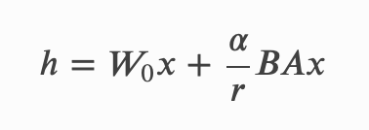
Efficient Parameters
Low Rank Adaptation(LoRA)
XW
W
Projection (h)
X

Slide 39
Efficient Parameters
Low Rank Adaptation(LoRA)
h1
W
Projection(h)
A
X
X

Slide 40
Efficient Parameters
Low Rank Adaptation(LoRA)
h1
W
Projection(h)
r
A
X
X

Slide 41
Efficient Parameters
Low Rank Adaptation(LoRA)
h1
W
B
Projection(h)
A
X
X

Slide 42
Efficient Parameters
Low Rank Adaptation(LoRA)
h1
d
W
B
Projection(h)
A
X
X

Slide 43
Efficient Parameters
Low Rank Adaptation(LoRA)
h1
h2
W
B
Projection(h)
A
X
X

Slide 44
Efficient Parameters
Low Rank Adaptation(LoRA)
h1
h2
W
B
Projection(h)
A
X
X

Slide 45
Efficient Parameters
Low Rank Adaptation(LoRA)
h
h1
h2
W
B
Projection(h)
A
X
X

Slide 46
Efficient Parameters
Low Rank Adaptation(LoRA)
h
h1
h2
W
B
Projection(h)
A
X
X

Slide 47
Efficient Parameters
Low Rank Adaptation(LoRA)
h
h1
h2
User Chosen
Hyperparameter
Usually 2r
W
B
Projection(h)
A
X
X

Slide 48
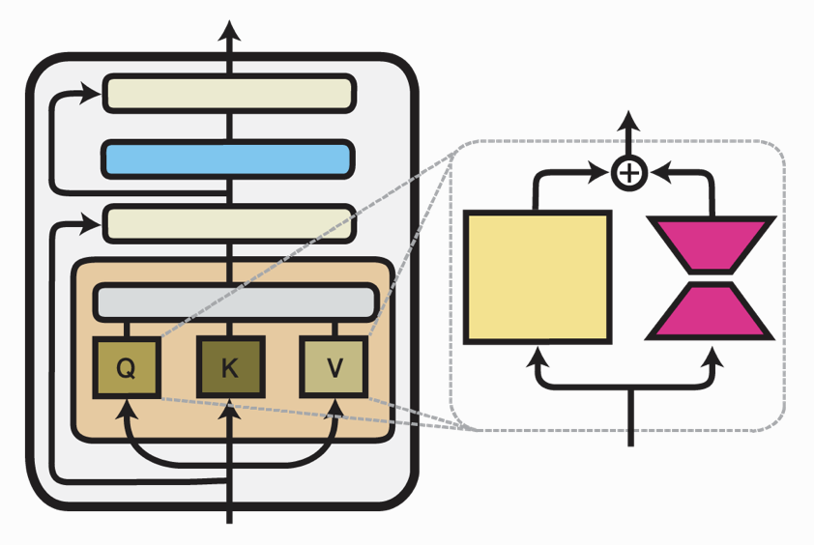
Efficient Parameters
Low Rank Adaptation(LoRA)
h
h1
h2
User Chosen
Hyperparameter
Usually 2r
W
B
Projection(h)
A
X
X

Slide 49
Efficient Parameters
Infused Adapter((IA)^3)
XW
W
Projection (h)
X

Slide 50
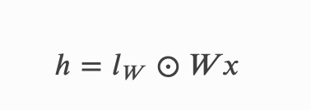
Efficient Parameters
Infused Adapter((IA)^3)
h
lw
W
Projection (h)
X

Slide 51
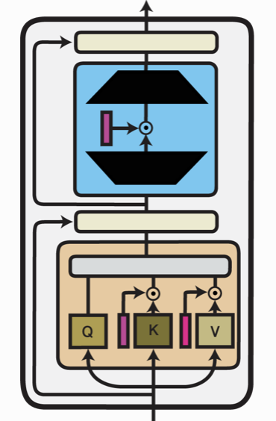
Efficient Parameters
Infused Adapter((IA)^3)
h
lw
W
Projection (h)
X

Slide 52
Efficient Parameters
h
h
h1
h2
lw
W
W
B
Projection (h)
Projection(h)
A
X
X
X

Slide 53
Efficient Parameters
→ Efficient to Train
h
h
h1
h2
lw
W
W
B
Projection (h)
Projection(h)
A
X
X
X

Slide 54
Efficient Parameters
→ Efficient to Train
→ task-specific modifications
h
h
h1
h2
lw
W
W
B
Projection (h)
Projection(h)
A
X
X
X

Slide 55
Efficient Parameters
→ Efficient to Train
→ task-specific modifications
→ Doesn’t require retaining of weight for individual tasks
h
h
h1
h2
lw
W
W
B
Projection (h)
Projection(h)
A
X
X
X

Slide 56
Efficient Parameters
→ Efficient to Train
→ task-specific modifications
→ Doesn’t require retaining of weight for individual tasks
h
h
h1
h2
lw
W
W
B
Projection (h)
Projection(h)
A
X
X
X

Slide 57
Efficient Parameters
Results on the Baseline Generator
 | Full fine-tune | LoRA(r=16) | LoRA(r=32) | LoRA(r=64) | LoRA(r=128) | (IA)^3
Trainable Parameters | ~60.5M | ~590k | ~1.18M | ~2.35M | ~4.75M | ~45k
Exact Match | 79.43 | 73.03 | 74.33 | 76.54 | 78.72 | 67.37
F1 Score | 85.97 | 79.86 | 81.32 | 82.95 | 84.86 | 72.48

Slide 58
Data Pre-processing for FiD
HPQA

Slide 59
Data Pre-processing for FiD
HPQA

Slide 60
Data Pre-processing for FiD
HPQA
Database

Slide 61
Data Pre-processing for FiD
HPQA
Database
BM25

Slide 62
Data Pre-processing for FiD
HPQA
Database
BM25

Slide 63
Data Pre-processing for FiD
HPQA
Database
BM25

Slide 64

Data Pre-processing for FiD
HPQA
10%
Database
BM25

Slide 65
Data Pre-processing for FiD
HPQA
5%
Database
BM25

Slide 66
FiD Modifications
Encoder
Answer
(Autoregressively)
Decoder
Encoder
Encoder

Slide 67
FiD Modifications
Challenges:
220M parameters
90K+ training examples
Encoder output: 51200*768
16GB VRAM
No background Training
Encoder
Answer
(Autoregressively)
Decoder
Encoder
Encoder

Slide 68
FiD Modifications
Challenges:
220M parameters
90K+ training examples
Encoder output: 51200*768
16GB VRAM
No background Training
Encoder
Answer
(Autoregressively)
Decoder
Encoder
Encoder

Slide 69
FiD Modifications
Challenges:
220M parameters
90K+ training examples
Encoder output: 51200*768
16GB VRAM
No background Training
Encoder
Answer
(Autoregressively)
Decoder
Encoder
Encoder

Slide 70
FiD
Challenges:
220M parameters
90K+ training examples
Encoder output: 51200*768
16GB VRAM
No background Training
Encoder
Answer
(Autoregressively)
Decoder
Encoder
Encoder

Slide 71
FiD
Challenges:
220M parameters
90K+ training examples
Encoder output: 51200*768
16GB VRAM
No background Training
Encoder
Answer
(Autoregressively)
Decoder
Encoder
Encoder

Slide 72
FiD
Challenges:
220M parameters
90K+ training examples
Encoder output: 51200*768
16GB VRAM
No background Training
Encoder
Answer
(Autoregressively)
Decoder
Encoder
Encoder

Slide 73
Encoder Decoder Analogy
Encoder
Decoder

Slide 74
Encoder Decoder Analogy
Encoder
Decoder

Slide 75
FiD
Encoder
Answer
(Autoregressively)
Decoder
Encoder
Encoder

Slide 76
FiD-eff
Encoder
Answer
(Autoregressively)
Decoder
Encoder
Encoder

Slide 77
FiD-eff
Encoder
Answer
(Autoregressively)
Decoder
Encoder
Encoder

Slide 78
FiD Modifications
Encoder
Answer
(Autoregressively)
Decoder
Encoder
Encoder

Slide 79
FiD Modifications
Initialised with weights from model trained on Natural Questions
Encoder
Answer
(Autoregressively)
Decoder
Encoder
Encoder

Slide 80
FiD-eff (Weights from FiD-NQ)
Results on NQQA and HpQA (F1/EM(Latency))
k | Full | 128 | 64 | 32 | 16
NQ(DPR) 10 Passages | 49.18/40.28 (8.28ms) | 49.18/40.28 (8ms) | 40.77/33.48 (7.56ms) | 27.71/20.91 (7.38ms) | 11.13/5.54 (7.26ms)
NQ(DPR) 25 Passages | 50.89/41.90 (24ms) | 50.89/41.90 (20ms) | 40.30/34.71 (18.8ms) | 30.31/23.11 (18.2ms) | 12.63/7.29 (18ms)
NQ(DPR) 50 Passages | 51.76/42.30 (48ms) | 51.76/42.30 (40ms) | 41.11/35.23 (39.2ms) | 31.25/23.89 (39ms) | 13.02/8.33 (38.9ms)
HpQA 25 Passages | 38.98/27.77 (17ms) | 32.80/21.97 (16.2ms) | 30.35/21.13 (15.6ms) | 18.24/11.51 (15.2ms) | 1.77/3.38 (15ms)

Slide 81
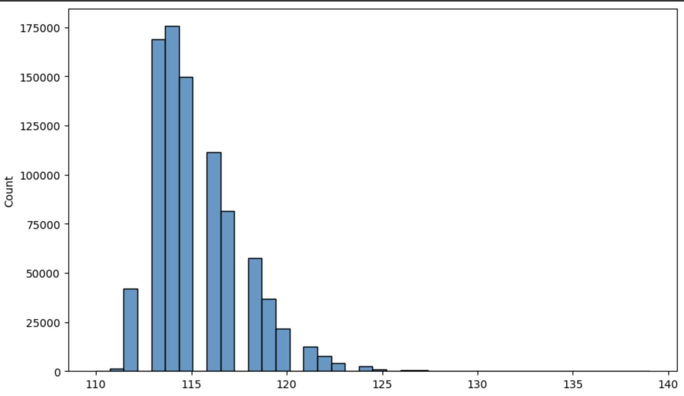
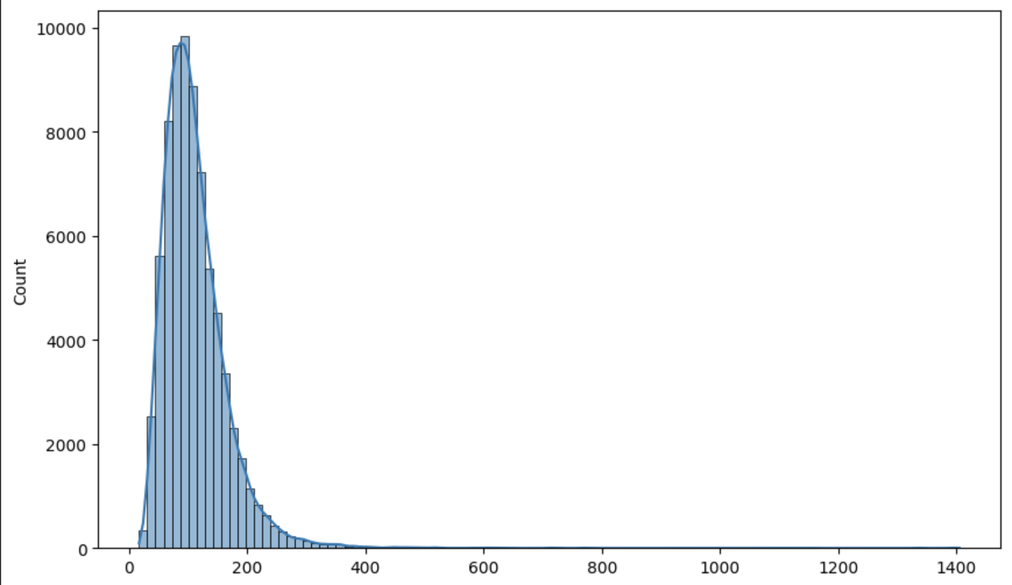
FiD-eff (Weights from FiD-NQ)
Results on NQQA and HpQA (F1/EM(Latency))
k | Full | 128 | 64 | 32 | 16
NQ(DPR) 10 Passages | 49.18/40.28 (8.28ms) | 49.18/40.28 (8ms) | 40.77/33.48 (7.56ms) | 27.71/20.91 (7.38ms) | 11.13/5.54 (7.26ms)
NQ(DPR) 25 Passages | 50.89/41.90 (24ms) | 50.89/41.90 (20ms) | 40.30/34.71 (18.8ms) | 30.31/23.11 (18.2ms) | 12.63/7.29 (18ms)
NQ(DPR) 50 Passages | 51.76/42.30 (48ms) | 51.76/42.30 (40ms) | 41.11/35.23 (39.2ms) | 31.25/23.89 (39ms) | 13.02/8.33 (38.9ms)
HpQA 10 Passages | 38.98/27.77 (17ms) | 37.80/26.97 (16.2ms) | 30.35/21.13 (15.6ms) | 18.24/11.51 (15.2ms) | 1.77/3.38 (15ms)

Slide 82
Encoder Decoder Analogy
Encoder
Decoder

Slide 83
Encoder Decoder Analogy
Encoder
Decoder

Slide 84
FiD-eff with convolution
Encoder
Answer
(Autoregressively)
Decoder
Encoder
Encoder

Slide 85
FiD-eff with convolution
Encoder
Answer
(Autoregressively)
Decoder
Encoder
Encoder

Slide 86
FiD-eff with convolution
Encoder
Answer
(Autoregressively)
Decoder
Encoder
Encoder
In my model it’s 32(yellow) + 16(Red) times n passages

Slide 87
FiD-eff with convolution
Encoder
Answer
(Autoregressively)
Decoder
Encoder
Encoder
48
4800

Slide 88
1D Convolution
Kernel Size: 64
Input channel: 768
Output channel: 768
Stride: 32
Kernel Size
Channel Size
Stride

Slide 89
FiD-eff with convolution
f
Encoder
Answer
(Autoregressively)
Decoder
Encoder
f
Encoder
48
4800

Slide 90
FiD-eff with convolution
f
Encoder
Answer
768*512
(Autoregressively)
Decoder
Encoder
f
Encoder
48
4800

Slide 91
FiD-eff with convolution
After adding Adapter LoRA(r=64) and (IA)^3
Number learnable parameters are ~9.3M
f
Encoder
Answer
768*512
(Autoregressively)
Decoder
Encoder
f
Encoder
48
4800

Slide 92
FiD-eff with convolution
After adding Adapter LoRA(r=64) and (IA)^3
Number learnable parameters are ~9.3M
f
Encoder
Answer
768*512
(Autoregressively)
Decoder
Encoder
f
Training:
Batch Size: 2
Gradient Accumulation: 64
Learning Rate: 10e-4
Optimizer: AdamW
Gradient Steps: ~2.5K
Encoder
48
4800

Slide 93
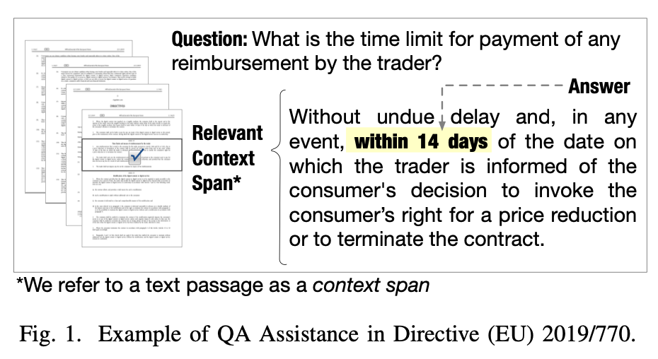
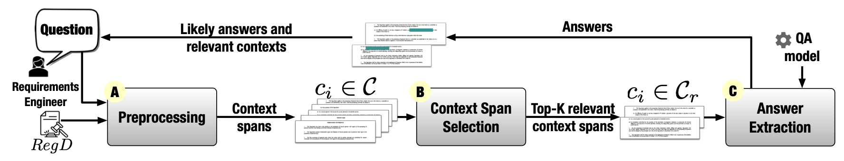
Case Study (Evaluation on Unseen Corpus)
Question Answering For Compliance Requirements
Dataset contains 3 documents, with 88 questions
RegD1: GDPR #Questions: 36, #Articles: 301
RegD2: EU regulations directive #Questions: 33 #Articles: 120
RegD3: EU sales directive #Questions: 19 #Articles: 102

Slide 94
Original Model(BCE)
0…1
Top K
____________
Input:
[cls] query [sep] context [sep]
According to the each sentence of the context spans is sent in to the bert(along with the query), and best sentence score is considered as the context score.
0…1
0…1
Classifier
Classifier
Classifier
BERT
BERT
BERT
Query
[SEP]
Sentence
Query
[SEP]
Sentence
Query
[SEP]
Sentence

Slide 95
Modified Model
Scores
Top N
BCE
Top K
F(a, b)
____________
H@n
Picking top n passages for the given query, from bi-encoder model.
Here all context spans are encoded and stored in memory, So when a query is made it is encode and compared with all the context spans to get the top k ones which later feed into cross-encoder along with the query.
 |  |  | a
 |  |  | b
BERT Like Model
BERT Like Model
Query
Context
Offline Indexing

Slide 96
Results and Discussion

Slide 97
FiD-eff with conv
Compared to SOTAs from KILT(HotpotQA)
 | F1 | EM
FiD-Light (40 passages)(2023) (11B) | 53.85 | 42.52
SEAL (generative)(2021) (11B) | 51.44 | 40.46
FiD with RS (200 passages)(2022) (11B) | 50.15 | 39.05
BART + DPR (100 passages)(2021) | 41.56 | 31.77
RAG (100 passages)(2021) (>3B) | 36.03 | 26.97
FiD-eff with conv (25 passages) (220M) (Ours) | 48.66 | 38.92

Slide 98
FiD-eff with conv
Pre-trained vs 10 vs 25 passages
 | F1 | EM
FiD-eff 32 without conv(25 passages) (220M)(FiD-NQ weights) | 18.24 | 11.51
FiD-eff 64 without conv(25 passages) (220M)(FiD-NQ weights) | 30.35 | 21.13
FiD-eff with conv (10 passages) (220M) (Ours) | 44.66 | 33.58
FiD-eff with conv (25 passages) (220M) (Ours) | 48.73 | 38.92

Slide 99
FiD-eff with conv
On different types of questions (10 Passages)
 | F1 | EM
Bridge | 62.22 | 56.56
Comparison | 40.25 | 27.80
Overall | 44.66 | 33.58

Slide 100
Baseline Model
Module 1: Passage Selector
 | F1 | EM
Easy | 91.81 | 74.73
Medium | 88.91 | 66.76
Hard | 87.13 | 63.82
Bridge | 87.32 | 62.67
Comparison | 97.34 | 90.78
Overall | 89.33 | 68.03

Slide 101
Baseline Model
Module 2: Sentence Extractor
 | F1 | EM
Easy | 85.32 | 55.21
Medium | 86.32 | 53.51
Hard | 82.93 | 46.84
Bridge | 84.03 | 47.98
Comparison | 91.53 | 72.22
Overall | 85.56 | 52.73

Slide 102
Baseline Model
Module 3: Answer Generator
 | F1 | EM
Easy | 83.55 | 74.16
Medium | 90.19 | 86.23
Hard | 73.51 | 59.69
Bridge | 88.53 | 81.29
Comparison | 75.45 | 71.83
Overall | 85.97 | 79.43

Slide 103
Baseline Model
Overall
 | F1 | EM
Easy | 83.55 | 74.16
Medium | 90.19 | 86.23
Hard | 73.51 | 59.69
Bridge | 88.53 | 81.29
Comparison | 75.45 | 71.83
Overall | 60.56 | 48.32

Slide 104
Compliance Requirements
BM25 vs Bi-Encoder
 | BM25 | DPR
R@5 | 89.77 | 71.59
R@10 | 93.18 | 86.36
R@20 | 94.32 | 94.32
R@30 | 96.59 | 96.59
R@40 | 96.59 | 97.73
R@50 | 96.59 | 98.86

Slide 105
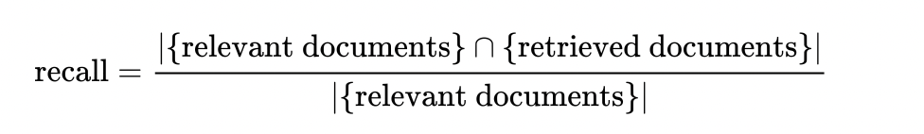
Compliance Requirements
Total(all docs): 523 Articles, 88 Questions
 | R@1 | R@3 | R@5 | R@10 | Time
BCE(Thiers) | 54.55 (48) | 63.16 (69) | 90.90 (80) | 92.05 (81) | 4.29s
BE+RR: H@20 | 56.82 (50) | 81.81 (72) | 89.77 (79) | 90.90 (80) | 1.99s
BE+RR: H@30 | 53. 41 (47) | 79.54 (70) | 90.90 (80) | 93.18 (82) | 2.04s
BE+RR: H@40 | 53. 41 (47) | 79.54 (70) | 90.90 (80) | 93.18 (82) | 2.09s
BE+RR: H@50 | 52.27 (46) | 79.54 (70) | 90.90 (80) | 92.05 (81) | 2.15s

Slide 106
Compliance Requirements
RegD1: 301 Articles, 36 Questions
 | R@1 | R@3 | R@5 | R@10 | Time per ques
BCE(Thiers) | 63.89 (23) | 91.67 (33) | 94.44 (34) | 94.44 (34) | 3.32s
BE+RR: H@20 | 69.44 (25) | 91.67 (33) | 94.44 (34) | 94.44 (34) | 1.99s
BE+RR: H@30 | 63.89 (23) | 91.67 (33) | 94.44 (34) | 94.44 (34) | 2.05s
BE+RR: H@40 | 63.89 (23) | 91.67 (33) | 94.44 (34) | 94.44 (34) | 2.11s
BE+RR: H@50 | 63.89 (23) | 91.67 (33) | 94.44 (34) | 94.44 (34) | 2.16s

Slide 107
Compliance Requirements
RegD2: 120 Articles, 33 Questions
 | R@1 | R@3 | R@5 | R@10 | Time per ques
BCE(Thiers) | 63.64 (21) | 84.85 (28) | 87.88 (29) | 90.90 (30) | 2.45s
BE+RR: H@20 | 63.64 (21) | 90.90 (30) | 90.90 (30) | 93.94 (31) | 2.00s
BE+RR: H@30 | 63.64 (21) | 87.88 (29) | 90.90 (30) | 93.94 (31) | 2.04s
BE+RR: H@40 | 63.64 (21) | 84.85 (28) | 90.90 (30) | 90.90 (31) | 2.09s
BE+RR: H@50 | 63.64 (21) | 84.85 (28) | 87.88 (29) | 90.90 (30) | 2.14s

Slide 108
Compliance Requirements
RegD3: 102 Articles, 19 Questions
 | R@1 | R@3 | R@5 | R@10 | Time
BCE(Thiers) | 47.37 (9) | 63.16 (12) | 94.74 (18) | 94.74 (18) | 2.35s
BE+RR: H@20 | 47.37 (9) | 68.42 (13) | 89.47 (17) | 94.74 (18) | 1.99s
BE+RR: H@30 | 42.11 (8) | 68.42 (13) | 89.47 (17) | 94.74 (18) | 2.04s
BE+RR: H@40 | 47.37 (9) | 73.68 (14) | 94.74 (18) | 94.74 (18) | 2.09s
BE+RR: H@50 | 47.37 (9) | 73.68 (14) | 94.74 (18) | 94.74 (18) | 2.13s

Slide 109
Compliance Requirements
RegD3: 102 Articles, 19 Questions
 | R@1 | R@3 | R@5 | R@10 | Time
BCE(Thiers) | 47.37 (9) | 63.16 (12) | 94.74 (18) | 94.74 (18) | 2.35s
BE+RR: H@20 | 47.37 (9) | 68.42 (13) | 89.47 (17) | 94.74 (18) | 1.99s
BE+RR: H@30 | 42.11 (8) | 68.42 (13) | 89.47 (17) | 94.74 (18) | 2.04s
BE+RR: H@40 | 47.37 (9) | 73.68 (14) | 94.74 (18) | 94.74 (18) | 2.09s
BE+RR: H@50 | 47.37 (9) | 73.68 (14) | 94.74 (18) | 94.74 (18) | 2.13s

Slide 110
Conclusion

Slide 111
Adapters Were Quite Effective on both baseline and FiD-eff

Slide 112
Adapters Were Quite Effective on both baseline and FiD-eff
Model’s performance improved quite significantly from the pre-trained model

Slide 113
Adapters Were Quite Effective on both baseline and FiD-eff
Model’s performance improved quite significantly from the pre-trained model
Model’s performance on COREQQA is as good as Baseline but also Reasonably has low latency

Slide 114
References
KILT: a Benchmark for Knowledge Intensive Language Tasks
Retrieval-Augmented Generation for Knowledge-Intensive NLP Tasks
Leveraging Passage Retrieval with Generative Models for Open Domain Question Answering
Autoregressive Search Engines: Generating Substrings as Document Identifiers
Generative Multi-hop Retrieval
Autoregressive Entity Retrieval
HOTPOTQA: A Dataset for Diverse, Explainable Multi-hop Question Answering
TriviaQA: A Large Scale Distantly Supervised Challenge Dataset for Reading Comprehension
FEVER: a large-scale dataset for Fact Extraction and VERification
Zero-Shot Relation Extraction via Reading Comprehension
T-REx: A Large Scale Alignment of Natural Language with Knowledge Base Triples
Automated Question Answering for Improved Understanding of Compliance Requirements: A Multi-Document Study
Automated Generating Natural Language Requirements based on Domain Ontology
Talk on Generative Search Engines, By Dr. Minjoo Seo, Professor, KAIST
Natural Questions: A Benchmark for Question Answering Research

